Slide 1
CS383 - Enterprise Web Application Development
Module 1: Bootstrap
Part 01

Slide 2
Content
Introduction. What is Bootstrap?
Enterprise Web App Architecture. Where is Bootstrap?
Advantages of using Bootstrap
Setup
Bootstrap content
Browsers/Devices Support
Notes / Recommendations

Slide 3
Introduction
Bootstrap is a front-end open source framework for fast web development
Premade CSS templates and JavaScript Plugins/Widgets
Native responsive layout

Slide 4
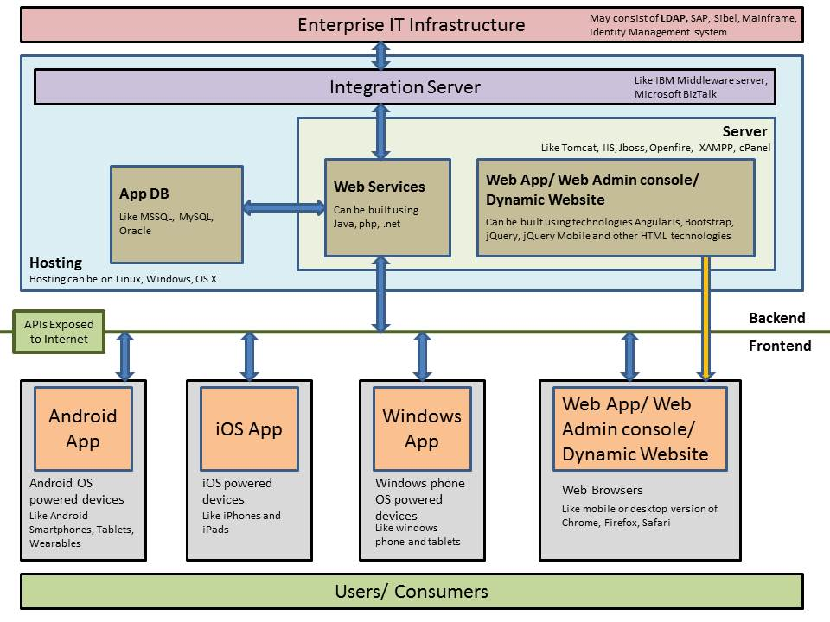
Enterprise Web Applications Architecture
Source: http://www.tarkashilpa.com/

Slide 5
Advantages
Easy and faster front-end development
Native premade UI components (Interface Design)
Browser compatibility
Responsive

Slide 6
Bootstrap setup
Go to https://getbootstrap.com/ to download the latest version.
Select one of the setup options.
The easiest is to use BootstrapCDN which delivers cached version of Bootstrap’s compiled CSS and JS
More details about the setup is covered in the lab sessions.

Slide 7
Content
Bootstrap
CSS Components
Tables
Buttons
JS Widgets
Slider
Media Objects
…
Modal
Tooltips/
Popovers
…

Slide 8
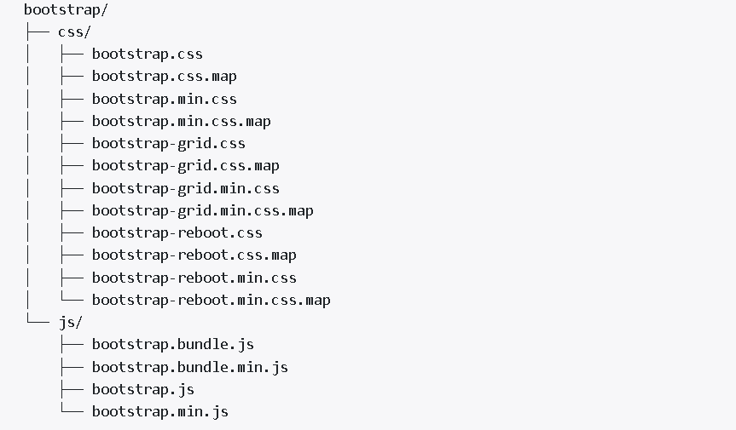
Content
Precompiled Bootstrap 4.0
Source: https://getbootstrap.com

Slide 9
Browsers/Devices Support
Bootstrap 4.0 supports the latest, stable releases of all major browsers and platforms.
On Windows, it supports Internet Explorer 10-11 / Microsoft Edge (dropped support for IE8/9)
Browsers which use the latest version of WebKit, Blink, or Gecko, whether directly or via the platform’s web view API, are not explicitly supported.
However, Bootstrap should (in most cases) display and function correctly in these browsers
Source: https://getbootstrap.com

Slide 10
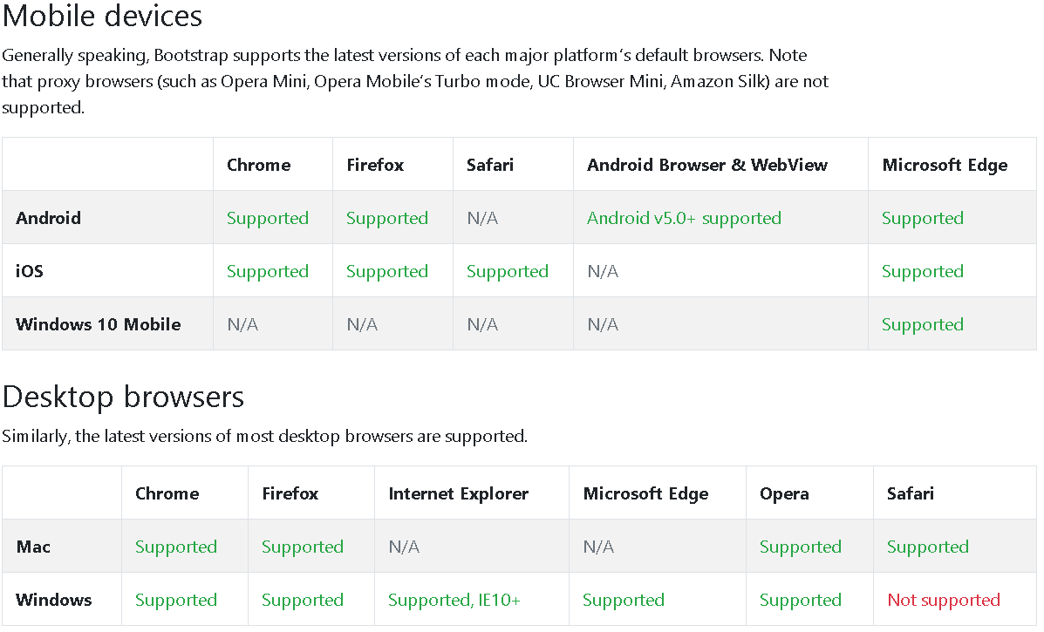
Browsers/Devices Support
Source: https://getbootstrap.com

Slide 11
Notes / Recommendations
In this course we will use the latest version of Bootstrap which is 4.0 Beta. If you have used an earlier version (4.0 alpha/3.0), it is recommended that you go through the changes summary : https://getbootstrap.com/docs/4.0/migration/#summary
It will always be better to stay connected with latest updates and changes to various technologies and tools, so we recommend that you try to join the Bootstrap community and get involved. You can find more about this here:
https://getbootstrap.com/docs/4.0/getting-started/introduction/#community

